Slide 1
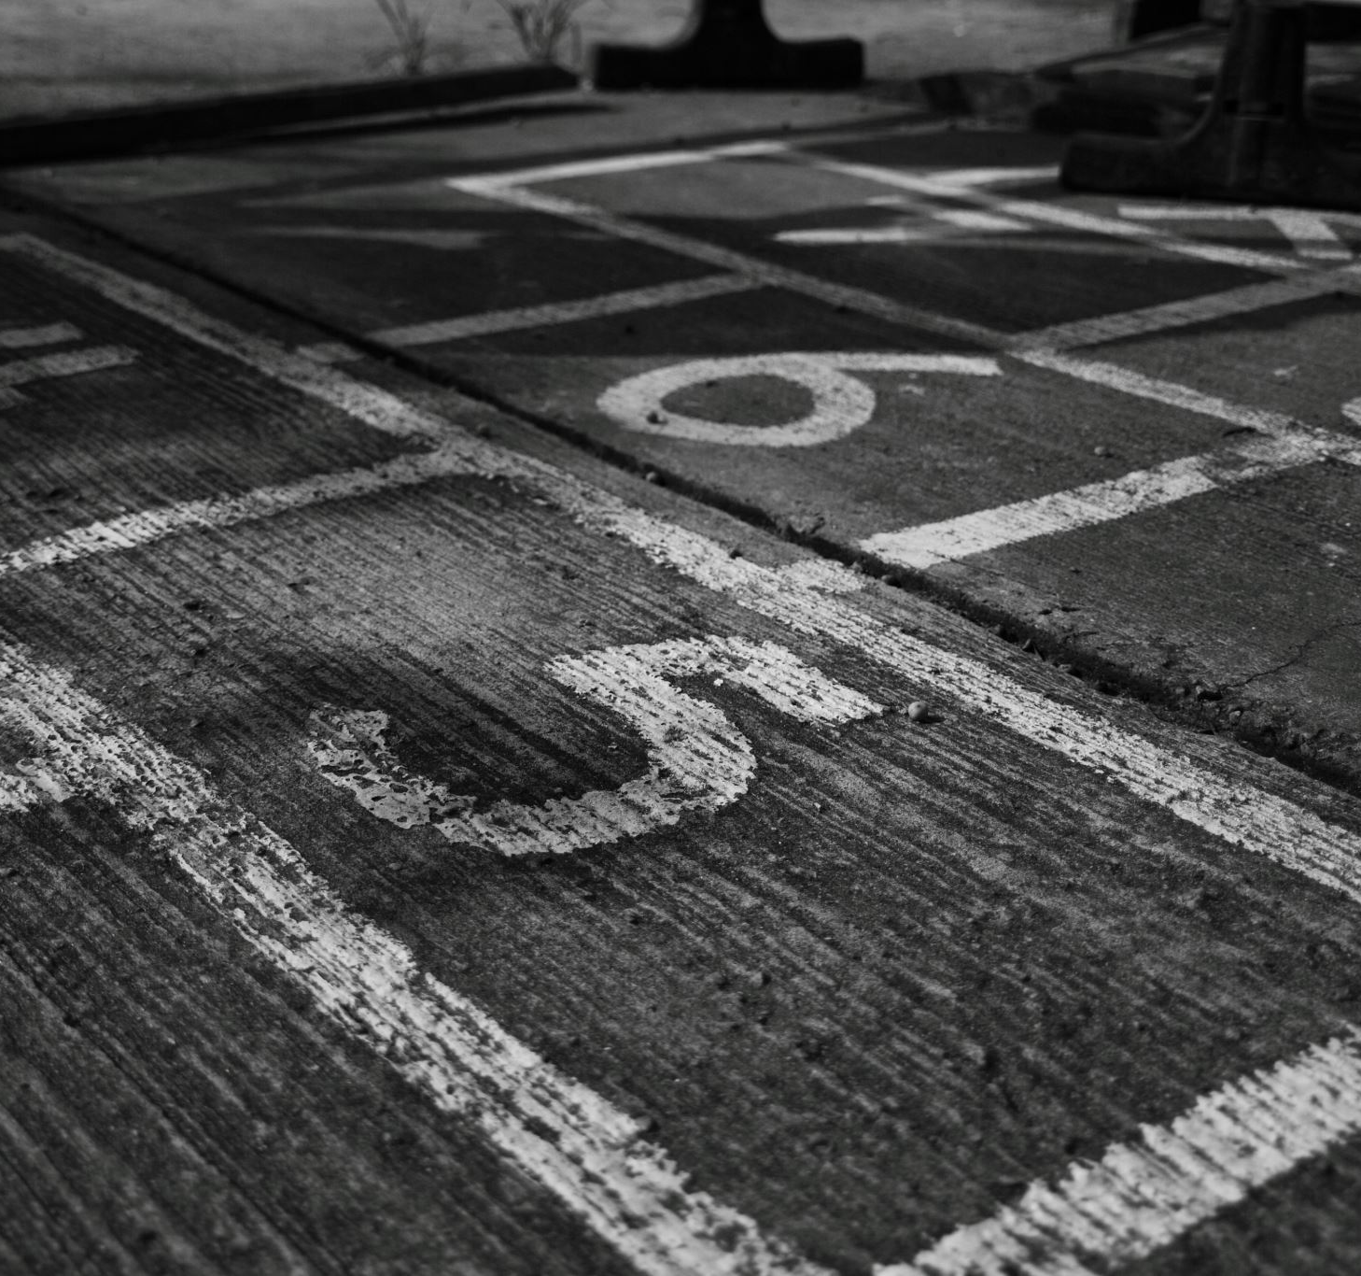
A path-planning algorithm for parallel automatic parking

Slide 2
Path-Planning Algorithm for Automatic Parking
Introduction
Holonomic and Nonholonomic Systems
Vehicle Kinematic Model
Shortest Path of Parallel Parking
Planning Collision-Free Region
Model Verification and Simulation

Slide 3
Introduction
Path-planning is a key issue of automatic parking assist system due to the non-holonomic constraints. A shortest path algorithm for the parallel parking problem in a certain condition is proposed and proved. A feasible path-planning approach is presented to meet the requirement that the parking space is narrow and needs parking iteratively by improving the shortest path. Considering several possibilities of collision with obstacles in the parking process, the parking region where the cars can park with no collision based on the proposed algorithm is designed. The proposed algorithm is verified combined with vehicle dynamics constraints under the limitation of the steering angle rotating speed.
In this project, after synthetically considering the problems such as path optimization, narrow space parking and path with no collision, we propose one kind of shortest collision free path in a certain condition to approach the car to the goal following a stable trajectory while avoiding the obstacles. And an iterative path-planning algorithm is presented to park in the narrow space which is not big enough to operate parking in one time.

Slide 4
II. Holonomic & Non-holonomic Systems
Holonomic Systems:
A holonomic system refers to a system that can independently control its position and orientation in all degrees of freedom.
In a holonomic system, each degree of freedom is controllable, This means that a holonomic robot can move laterally, rotate, and change orientation without needing to navigate in arcs or make complex maneuvers.
Non-holonomic Systems:
Systems that have constraints on their motion and cannot move independently in all degrees of freedom.
the number of control inputs (such as velocities or steering angles) is fewer than the number of degrees of freedom. As a result, the system cannot instantaneously change its position or orientation in any direction. Instead, it must follow certain constraints and specific motion patterns to achieve desired movements.

Slide 5
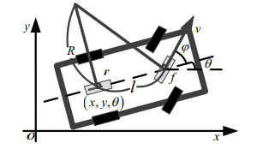
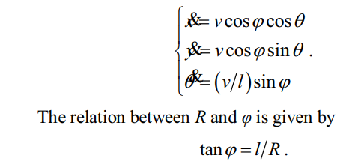
III. VEHICLE KINEMATIC MODEL
It is assumed that the vehicle moves with non-sliding method in the parking process because of the low speed. In the reference coordinate system, r is the midpoint of the rear wheel, f is the midpoint of the front wheel, x=x(t) and y=y(t)are the coordinates of r, θ=θ(t) is the course angle of the car with respect to global coordinate system, φ=φ(t) is the steering angle, v=v(t) is the velocity of f, l is the wheel base, R is turning radius of r.

Slide 6
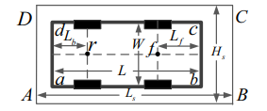
The parking environment can be constructed with the information from sensors . In which, abcd represent the four corners of car, while ABCD represent the four corners of parking space, let the length of rear and front overhang be Lb and Lf, L and H are length and width of car, and the length and width of parking space which dominate the difficulty of parking are defined as Ls and Hs.

Slide 7
IV. Planning SHORTEST PATH OF PARALLEL PARKING
The working procedure of path-planner is partitioned into two parts:
Firstly, the system decides whether the space is big enough to park by analyzing the information from the sensors.
Secondly, the planner generates a feasible collision free parking path with the consideration of choosing the appropriate start and end position if the space contents the parking requirement.
We plan our path under the following assumption:
The orientation of the car in start and end positions are parallel. In order to maintain this parallel relationship, the path in the first onstage of parking should be circle.
From (1), the nonholonomic constraint &y - &x tanθ = 0 should be in this model, in which the θ(t) is continuous. So derivative of the path (i.e. dy/dx) is continuous which is necessary if the path is feasible.
The information of parking bay and the coordinates of the start and end position are already given.

Slide 8
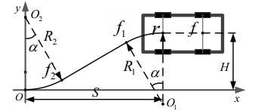
Circle-Straight line-Circle (CSC)
Where O1 and O2 are the circle centers of the first and final stage, R1 and R2 are the radius of the circles O1 and O2, f1 and f2 are tangency points between lines and circles O1 and O2. αis the angle of arc path, O the origin of the coordinate is ideal end position, S and H are the horizontal and vertical coordinates of start position. From Fig.3 the coordinates of O1 and O2 are (x1,y1)= (S,H-R1) and (x2,y2)= (0,R2), it is assumed in this model that the tangent equation is,
kx – y + m = 0

Slide 9
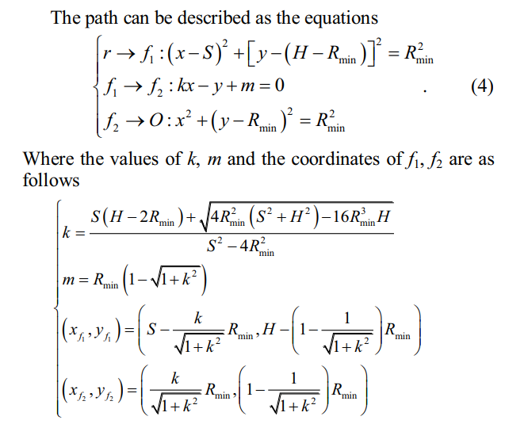
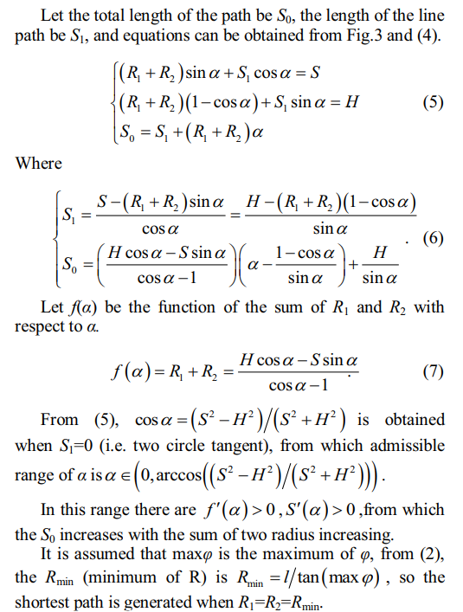

Slide 10
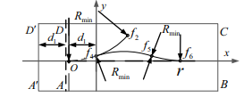
The parking space is defined as narrow space when the car fails to park by one operation. For narrow parking space, drivers may move forward and backward several times to park, the shortest parking path is improved to adjust the narrow space circumstance to a certain extent. We describe the two operations parking approach for simplicity of the iterative algorithm for example.
ABCD is real space, A’BCD’ is ideal space.
Let Li be the ideal length of parking space which is longer than the real Ls by d1.
the car should stop at f4 in the path from f2 to O to avoid collision with AD.
Then by turning the steering wheel to the other side that makes the car move with radius of Rmin from f4 to f5.Then change the steering angle to the other side again to make the car move from f5 to f6 with the same radius.

Slide 11
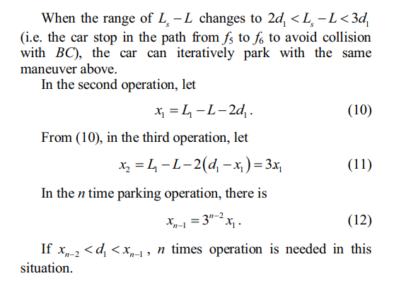
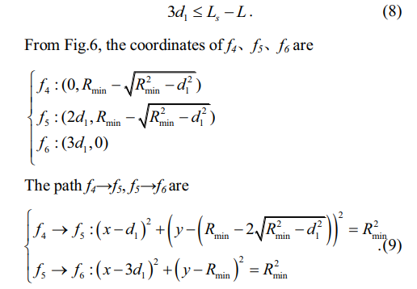

Slide 12


V. PLANNING The Parking Space Environment
the start and end positions are given. But the path-planner in parking assist system should also concern about the collision avoidance problem based on the planned path.
R_min is occurred when φ is max,
R_min = l / φ_max
The side clearance between ab and AB is
The front clearance between b and C is
So, The minimum length of parking space is

Slide 13
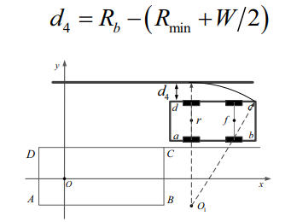
The minimum width the of parking space is
Hs = W + d2
The minimum parallel distance between the car and an obstacle is
The width of the track is

Slide 14
VI. Model Verification and Simulation
In order to evaluate the proposed geometric path planning and steering controls for parallel reverse parking in one trial, simulation results using MATLAB were conducted.
The actual dimensions of the vehicle should be considered, The parameters of the test vehicle are:
The car's length (L_Car) = 30 cm
The car's width (W_Car) = 12 cm
The wheel base (L_axi) = 18 cm
The front overhang (Lf) = 5 cm
The rear overhang (Lb) = 7 cm
The maximum turning angle for steering wheel is within a range of (40 : 35) for each side, The maximum turning angle (phi_max) = 40
The ratio between wheelbase and crossbase, the coefficients average values are gained is (0.55, 0.56, 0.66), The ratio between wheelbase and crossbase (kb) = W_Car / L_axi = 0.66
The turning ratio (R_min) = L_axi / Phi_max = 21.45 cm

Slide 15
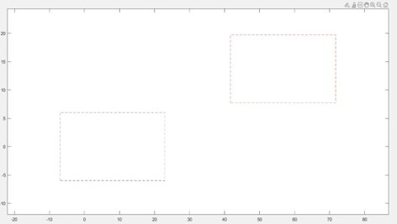
To specify the parking space environment, the following consideration parameters should be taken:
Minimum side clearance (d2) = 0.87
Minimum front clearance (Rb) = 35.81
Minimum length of parking space (Ls) = 39.30
Minimum Width of parking space (Hs) = 15.50
The coordinate points of the parking space

Slide 16
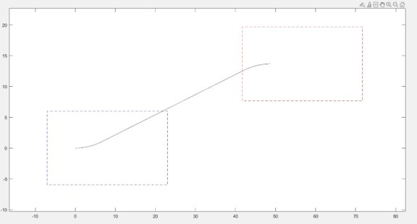
Initial position and orientation of the vehicle :
The horizontal coordinate of start position (S) = Ls
The minimum parallel distance between the car and the obstacle d3
The vertical coordinate of start position (H) = W_Car + d3
We have three phases of movement,
From start position r to f1
From f1 to f2
From f2 to end position O

Slide 17
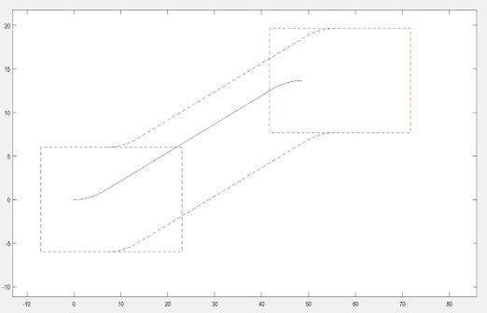
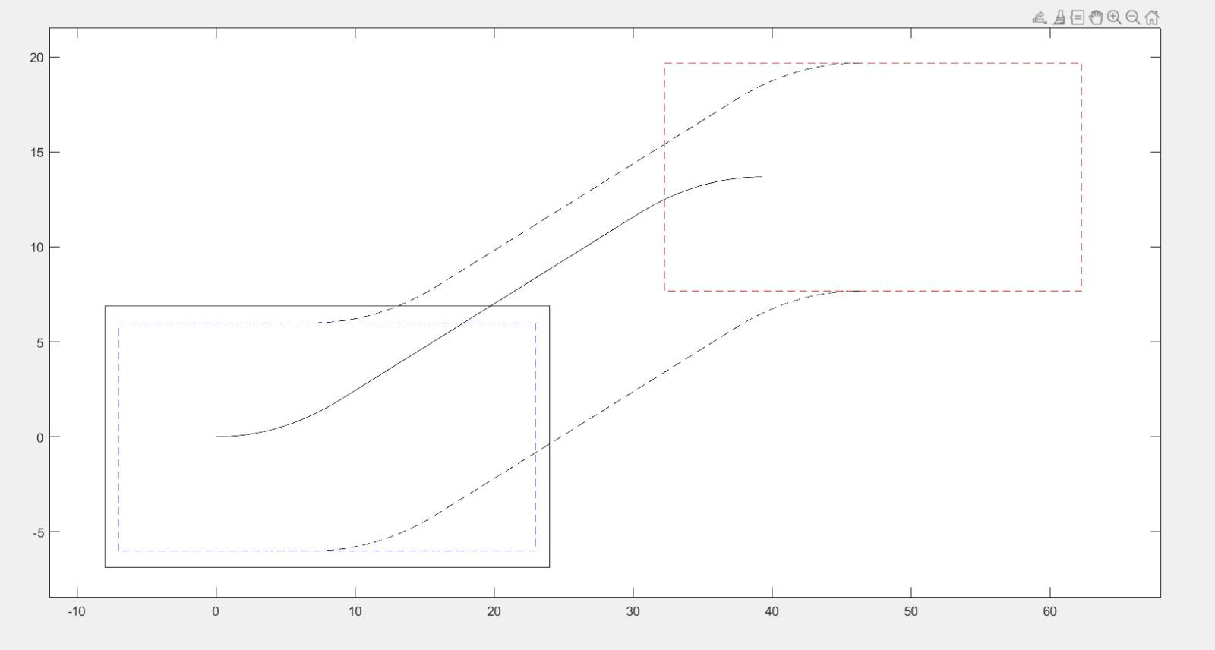

Slide 18
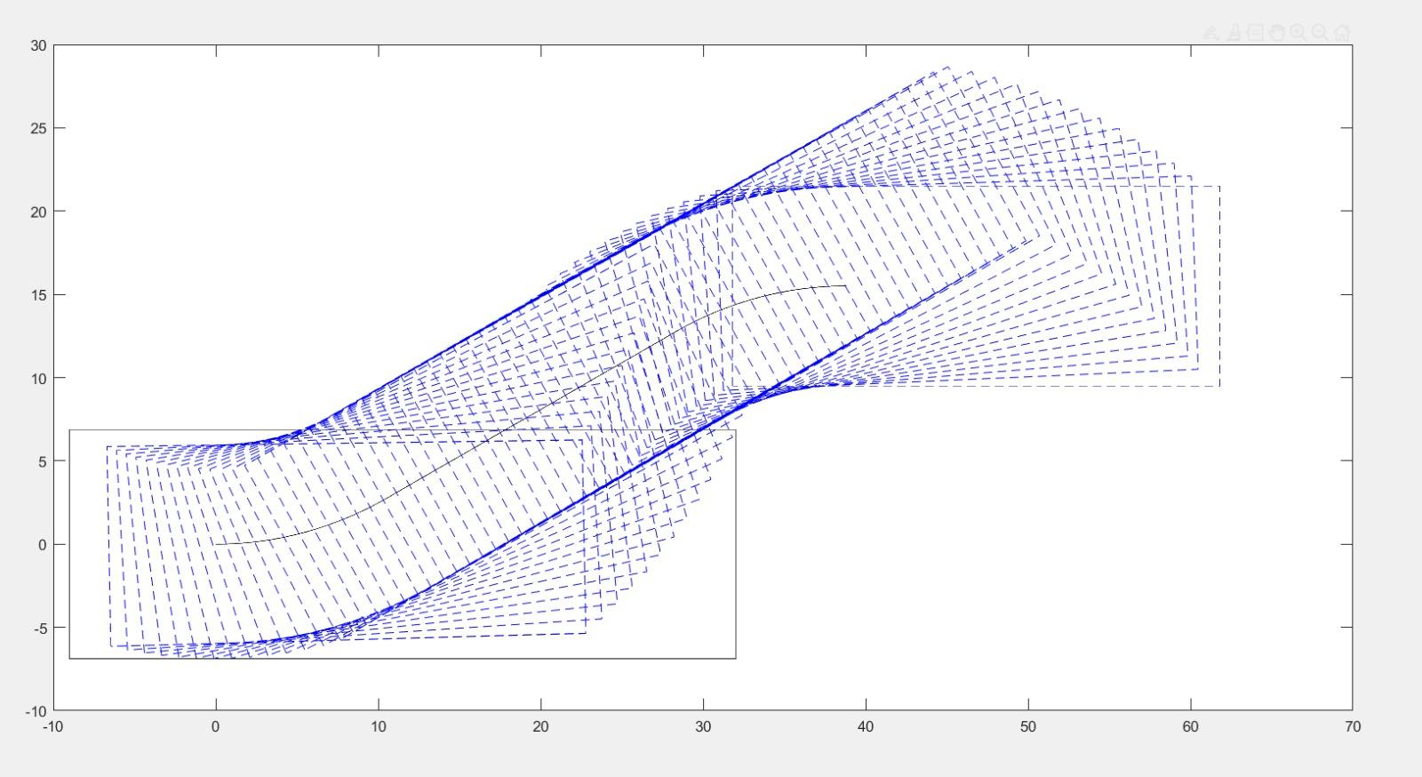

Slide 19
Thank you

